Slide 1

The Power of AWS Cloud Computing
Join us as we take a deep dive into Amazon Web Services (AWS) and explore its vast capabilities. From global infrastructure to container management, we'll show you how AWS can empower your organization
K.JANAKIRAM
21AK5A0316

Slide 2
AWS Global Infrastructure and Availability Zones
Highly-reliable
Availability zones are isolated locations within a region that contain their own power, networking, and connectivity capabilities, which provides enterprises with high levels of uptime.
1
2
3
Global presence
Diverse services
AWS spans across 25 geographic regions, with a total of 80 availability zones around the world, and plans to expand further.
With AWS, businesses can choose from over 200+ services such as storage, security, databases, machine learning, and more, which run across different availability zones to provide high resilience.

Slide 3
Key AWS Services and Offerings
EC2
S3
Lambda
Amazon Elastic Compute Cloud (EC2) is a web service that provides scalable computing capacity in the cloud. Users can run applications in an environment that manages compute resources on behalf of the users.
Amazon Simple Storage Service (S3) provides object storage in the cloud for applications. With S3, businesses can store and retrieve data from anywhere using HTTP or HTTPS protocols, in a secure, fast and cost-efficient manner.
AWS Lambda lets users run code without provisioning or managing servers. It's a serverless compute service that runs code in response to events and automatically manages the compute resources.
RDS
Amazon Relational Database Service (RDS) helps users build, run and scale database applications. It’s a managed service that provides customers with access to the capabilities of MySQL, MariaDB, PostgreSQL, Oracle, and SQL Server databases.

Slide 4
AWS Security and Compliance Measures
1
Data security
AWS allows customers to encrypt their data in transit and at rest to ensure maximum security. AWS follows security best practices and is compliant with many regulatory compliance frameworks such as PCI DSS, GDPR, HIPAA and ISO-27001.
2
Identity and Access Management
With AWS Identity and Access Management (IAM), users can securely control access to their AWS resources by managing users, assigning permissions, and creating policies that grant or deny access to resources.
3
Threat detection and monitoring
AWS provides continuous monitoring of accounts, services, and data to help mitigate security risks and threats. AWS also offers a number of security services to detect and protect against known threats and vulnerabilities.

Slide 5

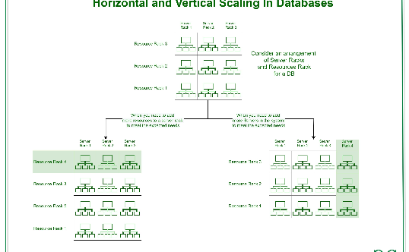
AWS Elasticity and Scalability Features
Elastic infrastructure
Horizontal scaling
Vertical scaling
AWS offers instant scalability, meaning users can easily add or remove computing resources based on demand to accommodate fluctuations in traffic or business needs.
AWS lets users scale out horizontally, distributing incoming traffic across multiple instances, allowing the system to handle increases in traffic without decreasing performance.
Vertical scaling enables customers to increase the capacity of an instance by increasing its power, or size. AWS allows users to upgrade an instance’s CPU, memory and storage capacity on the fly.

Slide 6

Cost Optimization and Pricing Models on AWS
1
Pay per use
2
Cost optimization tools
3
Reserved instances
AWS's pay-per-use model allows businesses to achieve cost savings by only paying for the actual compute and storage resources used.
AWS offers several tools such as AWS Cost Explorer, AWS Budgets, and AWS Optimizer to help users make informed decisions about spending and cost management.
Reserved instances lead to significant savings compared to the on-demand prices. Users can plan ahead and purchase "reserved instances" for a period of 1-3 years to avail discounts of up to 75%.

Slide 7
AWS Serverless Architecture and Benefits
Reduced infrastructure cost
Flexible pricing
Scalability and maintenance
With serverless architecture, users no longer need to manage servers. This translates to lower operating and maintenance costs.
Users only pay for what they use, with charges based on the number of executions rather than the time servers are active.
With a pay-per-use model, ">users do not have to worry about underutilizing servers. AWS handles all operational aspects, and users gain scalability, reliability, and efficiency benefits.

Slide 8
Managing Containers with AWS
Fargate
Fargate is a serverless compute engine for containers that provides users the option to run containers without the need for server infrastructure management.
1
2
3
Elastic Container Service (ECS)
EKS
ECS is a fully-managed container management service that enables developers to deploy and scale containerized applications easily and quickly.
Amazon Elastic Kubernetes Service (EKS) is a fully-managed Kubernetes service that automates the deployment and scaling of containerized applications in Kubernetes clusters.

Slide 9
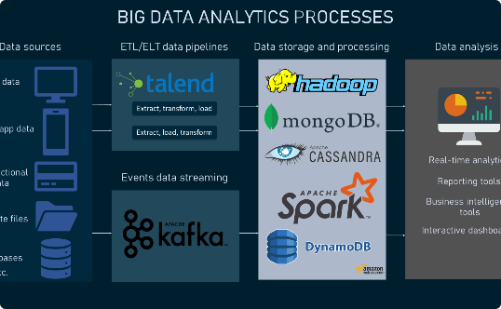
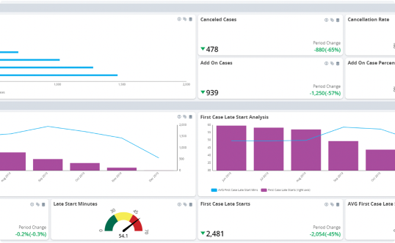
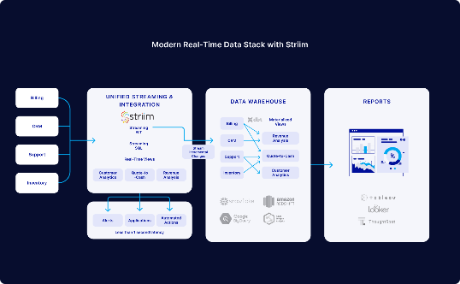
Big Data and Analytics Solutions on AWS
Amazon EMR
Amazon QuickSight
Amazon Kinesis
Amazon Elastic MapReduce (EMR) provides a managed Hadoop framework to process vast amounts of data. EMR also integrates with a range of other data platforms, such as Pig, Hive, and Spark.
Amazon QuickSight is a powerful BI and analytics service that makes it simple to build visualizations, perform ad-hoc analysis, and quickly get insights from data.
Amazon Kinesis is a family of data streaming and processing services that can be used to collect, process, and analyze real-time, streaming data.

Slide 10
Artificial Intelligence and Machine Learning with AWS
AWS SageMaker
Amazon Rekognition
AWS SageMaker is a fully managed machine learning service that enables data scientists and developers to build and deploy machine learning models quickly.
AWS Rekognition is a machine learning-based image and video recognition service that makes it easy to detect objects, scenes, and faces, and perform analysis on videos and images.
Amazon Comprehend
Amazon Personalize
Amazon Comprehend is a natural language processing service that analyzes text and identifies the language, dialect, entities, key phrases, and sentiment.
Amazon Personalize is a machine learning service that uses real-time and historical information to personalize user experiences across different applications.

Slide 11

Internet of Things (IoT) Applications on AWS
1
AWS IoT Core
2
AWS IoT Greengrass
AWS IoT Core connects devices to the cloud, enabling secure data exchange and communication among devices. AWS IoT also comes with easy integration with AWS analytics and machine learning services.
AWS IoT Greengrass is about extending cloud functionalities to connected devices. With AWS IoT Greengrass, users can perform data processing, inference, and secure messaging from edge devices.
3
AWS IoT Analytics
AWS IoT Analytics is a managed service that lets businesses analyze data collected from IoT devices and improve operational efficiencies, reduce costs and optimize device performance.

Slide 12
DevOps and CI/CD Practices on AWS
1
AWS CodeDeploy
AWS CodeDeploy automates software deployment, allowing rapid expansion of software services. CodeDeploy eliminates manual errors, increases throughput, and allows consistent deployments across various environments.
2
AWS CodePipeline
AWS CodePipeline is a fully managed service that helps users build and manage continuous delivery pipeline. It integrates with various other services like CodeCommit, CodeBuild, and CodeDeploy.
3
AWS Elastic Beanstalk
AWS Elastic Beanstalk automatically handles deployment, capacity provisioning, monitoring, and health checks for web applications. Beanstalk helps users to focus on coding by abstracting away deployment details.

Slide 13
High Availability and Disaster Recovery on AWS
Multi-region deployments
AWS Backup
Amazon S3
AWS allows users to deploy applications across multiple regions, which improves application availability and provides redundancy in case of a region-wide outage.
AWS Backup is a fully-managed service that provides easier and faster backup solutions to protect and restore business data. AWS Backup ensures data protection and disaster recovery across different services and regions.
Amazon S3 offers over 99.999999999% durability and stores data redundantly across different devices and multiple facilities in a region, providing a resilient infrastructure.

Slide 14
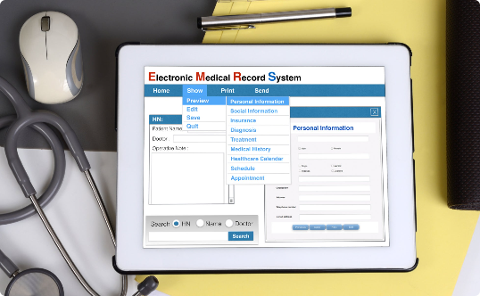


AWS Use Cases Across Different Industries
Healthcare
Logistics
Media and Entertainment
AWS is employed in the healthcare industry to streamline data management and enable customized services. One example is healthcare service provider Intermountain Healthcare.
AWS helps logistics firms to optimize their supply chain by enabling real-time tracking, inventory management, and predictive analytics. One example is FedEx, which leverages AWS to handle peak demand periods.
AWS is used to power streaming services, content production and distribution, and personalization, among other things. Netflix, an AWS customer since 2009, delivers all its streaming content through AWS.

Slide 15

Customer Success Story: Netflix on AWS
"We're running almost all of our infrastructure on AWS. If you ask me today if I want to buy a data center or, frankly, if I want to sign a lease for a piece of real estate, I would say 'Absolutely not.'" - Adrian Cockcroft, former Cloud Architect at Netflix -

Slide 16

Security Best Practices on AWS
Always use AWS best practices identity and access management (IAM) to secure access to AWS resources.
Enable encryption in transit for all applications, whether HTTP or HTTPS.
Use network security best practices to secure access to your infrastructure and applications. Implement firewalls, VPNs, and security groups to securely segregate traffic.
Enable security logging, audit logging, and monitoring to detect and respond to security breaches effectively.
Adhere to compliance regulations and follow AWS security standards as required by your organization’s security policy.

Slide 17

AWS Customer Support and Training Resources
1
AWS Organizations
2
AWS Support
AWS Organizations helps customers to manage and delegate access and compliance across multiple AWS accounts.
AWS provides 24/7 customer support and provides reliable, consistent technical assistance. The support plans include several service levels for different needs.
3
AWS Training and Certification
From foundational to specialized certifications, AWS offers training paths that help IT professionals master AWS technologies and build their cloud skills.

Slide 18

AWS Certifications and Career Opportunities
1
AWS Certified Solutions Architect Associate
AWS certifications help professionals validate their cloud computing skills and expertise. Top certifications include AWS Certified Solutions Architect Associate, AWS Certified DevOps Engineer, AWS Certified Solution Architect Professional and more.
2
Career opportunities
The demand for AWS-related skills continues to grow, with many in-demand job roles, including cloud architects, solutions architects, and cloud developers.

Slide 19
AWS and Hybrid Cloud Strategies
1
Hybrid cloud infrastructure
A hybrid infrastructure makes use of on-premises, private, and public cloud services. AWS provides several services, including Amazon Outposts, AWS Storage Gateway to integrate on-premise IT with the AWS cloud.
2
AWS Direct Connect
AWS Direct Connect is a dedicated network connection from a customer's on-premises infrastructure to AWS. Using Direct Connect, customers can create private network connections to the cloud that bypass the public internet.
3
AWS Landing Zone
AWS Landing Zone provides a foundation for customers migrating to the AWS cloud by establishing a secure, multi-account environment, with best practices and templates to deploy accounts.

Slide 20

Future Trends and Innovations in AWS
Edge computing is poised to become one of AWS's biggest areas of growth.
AWS plans to further integrate the machine learning and analytics services into its platform.
Quantum computing: one of the most ambitious projects that AWS is working on. AWS plans to introduce a fully-managed quantum computing service in the future.

Slide 21
THANK YOU

